Slide 1
ARTIFICIAL INTELLIGENCE AND EXPERT SYSTEM
Spring15-16
Intelligent Agents
Chapter 2
Credits:
Dr. Shamim Akhter
Ahmed Ridwanul Islam
Abdus Salam

Slide 2
Agents
An agent is anything that can be viewed as perceiving its environment through sensors and acting upon that environment through actuators
Human agent:
  Sensors: eyes, ears, and other organs
  Actuators: hands, legs, mouth, and other body parts
Robotic agent:
  Sensors: cameras and infrared range finders
  Actuators: various motors

Slide 3

Agents
The agent function maps from percept histories to actions:
Percept history is also known as percept sequence.
[f: P* → A]

Slide 4

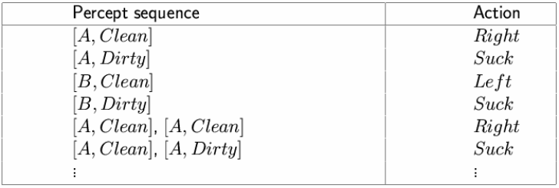
Vacuum-cleaner world
Percepts: location and contents, e.g., [A,Dirty]
Actions: Left, Right, Suck, NoOp
A vacuum-cleaner agent

Slide 5
Rational agents
An agent should strive to "do the right thing", based on
  what it can perceive and
  the actions it can perform
The right action is the one that will cause the agent to be most successful
Performance measure: An objective criterion for success of an agent's behavior
E.g., performance measure of a vacuum-cleaner agent could be
  amount of dirt cleaned up,
  amount of time taken,
  amount of electricity consumed,
  amount of noise generated, etc.

Slide 6
Rational agents
Rational Agent:
Given:
  Possible percept sequence,
  The evidence provided by the percept sequence and
  Whatever built-in knowledge the agent has.
Aim: For each possible percept sequence a rational agent should select an action
Subject to: maximize its performance measure.

Slide 7
Rational and Omniscience Agent
Omniscience agent knows the actual outcome of its actions, and can act accordingly.
Omniscience agent is impossible.
Aim: For each possible percept sequence a rational agent should select an action
In summary, rational at any time depends on 4 things
  The performance measure (degree of success)
  Percept sequence (perception history)
  Knowledge about the environment
  The performed actions

Slide 8
Ideal Rational agents
For each possible percept sequence, an ideal rational agent should do whatever action is expected to maximize its performance measure, on the basis of the evidence provided by the percept sequence and whatever built-in knowledge the agent has.

Slide 9
Mapping (Percept seq to actions )
A rule transfer percept sequences to action.
Very long list.
Mapping describe agents then ideal mapping describe ideal agents
Square root problem (Program and mapping table e.g).

Slide 10
Autonomy
Agent actions are completely based on the built-in knowledge (mapping table) then the agent called lacks autonomy. (e.g. clock)
Behavior can be based on both
    Its own experience
    Built-in-knowledge
Truly autonomous intelligent agent should be avoid unsuccessful result (e.g. dung beetle).

Slide 11
Rational agents
Rationality is distinct from omniscience (all-knowing with infinite knowledge)
Agents can perform actions in order to modify future percepts so as to obtain useful information (information gathering, exploration)
An agent is autonomous if its behavior is determined by its own experience (with ability to learn and adapt)

Slide 12
PEAS
Task environment – are essentially the ‘problems’ to which rational agents are ‘solutions’.
Task environment specified by PEAS:
  Performance measure
  Environment
  Actuators
  Sensors
Must first specify the setting for intelligent agent design

Slide 13
PEAS: Example 1
Agent: Automated taxi driver
Performance measure: Safe, fast, legal, comfortable trip, maximize profits
Environment: Roads, other traffic, pedestrians, customers
Actuators: Steering wheel, accelerator, brake, signal, horn
Sensors: Cameras, sonar, speedometer, GPS, odometer, engine sensors, keyboard

Slide 14
PEAS : Example 2
Agent: Medical diagnosis system
Performance measure: Healthy patient, minimize costs, lawsuits
Environment: Patient, hospital, staff
Actuators: Screen display (questions, tests, diagnoses, treatments, referrals)
Sensors: Keyboard (entry of symptoms, findings, patient's answers)

Slide 15
PEAS : Example 3
Agent: Part-picking robot
Performance measure: Percentage of parts in correct bins
Environment: Conveyor belt with parts, bins
Actuators: Jointed arm and hand
Sensors: Camera, joint angle sensors

Slide 16
PEAS : Example 4
Agent: Interactive English tutor
Performance measure: Maximize student's score on test
Environment: Set of students
Actuators: Screen display (exercises, suggestions, corrections)
Sensors: Keyboard

Slide 17
Environment types
Fully observable (vs. partially observable): An agent's sensors give it access to the complete state of the environment at each point in time.
Deterministic (vs. stochastic): The next state of the environment is completely determined by the current state and the action executed by the agent. (If the environment is deterministic except for the actions of other agents, then the environment is strategic)
Episodic (vs. sequential): The agent's experience is divided into atomic "episodes" (each episode consists of the agent perceiving and then performing a single action), and the choice of action in each episode depends only on the episode itself.

Slide 18
Environment types
Static (vs. dynamic): The environment is unchanged while an agent is deliberating.
  The environment is semi dynamic if the environment itself does not change with the passage of time but the agent's performance score does.
Discrete (vs. continuous): A limited number of distinct, clearly defined percepts and actions.
Single agent (vs. multiagent): An agent operating by itself in an environment.

Slide 19
Environment types
Chess with Chess without Taxi driving
a clock a clock
Fully observable Yes Yes No
Deterministic Strategic Strategic No
Episodic No No No
Static Semi Yes No
Discrete Yes Yes No
Single agent No No No
The environment type largely determines the agent design
The real world is (of course) partially observable, stochastic, sequential, dynamic, continuous, multi-agent

Slide 20
Agents and Environments
The agent function maps from percept histories to actions:
The agent program runs on the physical architecture to produce f
agent = architecture + program
[f: P* → A]

Slide 21
Agent functions and programs
An agent is completely specified by the agent function mapping percept sequences to actions
An agent function (or a small equivalence class) is rational
Aim: find a way to implement the rational agent function concisely

Slide 22
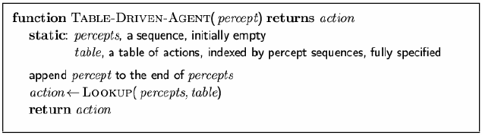
Table-lookup agent
Drawbacks:
  Huge table
  Take a long time to build the table
  No autonomy
  Even with learning, need a long time to learn the table entries

Slide 23
Agent types
Four basic types in order of increasing generality:
  Simple reflex agents
  Model-based reflex agents
  Goal-based agents
  Utility-based agents

Slide 24
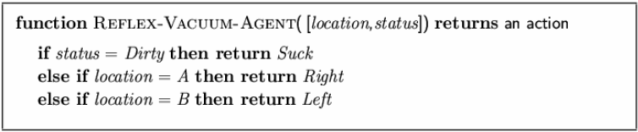
Simple reflex agents
These agents select actions on the basis of current percept, ignoring the rest of the percept history.
Agent program for a vacuum-cleaner agent

Slide 25

Simple reflex agents

Slide 26
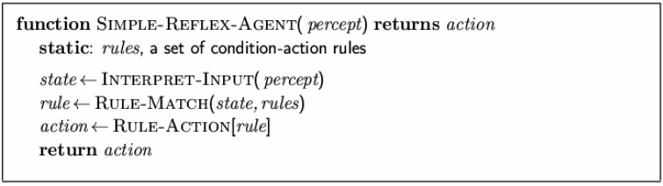
Simple reflex agents
This types of agents are very simple to implement.
They work properly if the correct decision can be made on the basis of current percept only i.e. if the environment is fully observable.
Example of vacuum cleaning agent with a dirt sensor only

Slide 27
Model-based reflex agents
To handle partial observability it is effective to keep track of the world it can’t see now.
i.e. an agent should maintain an internal state representing a model of the world. The state changes through percepts and actions.
Example:
  Changing state by percept: An overtaking car will generally be closer to behind than it was a moment ago.
  Changing state by action: If the car moves to the right lane there is a gap in the place before.

Slide 28

Model-based reflex agents

Slide 29
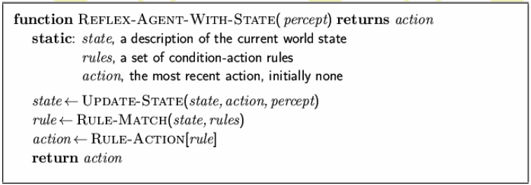
Model-based reflex agents

Slide 30
Goal-based agents
The state of environment is not always sufficient to decide what to do.
Example: At a road junction, the taxi can turn left, turn right, or go straight. The percept and internal state says it’s a junction but which way to go depend on the goal (what way is the passenger’s destination).

Slide 31

Goal-based agents

Slide 32
Utility-based agents
Goals sometimes are not enough to generate high quality behavior.
For example, out of many possible routes a taxi can follow, some are quicker, safer, more reliable and cheaper than others.
The degree of happiness while achieving a goal is represented by utility.
A utility function maps a state (or a sequence of states) onto a real number which describes the degree of happiness.

Slide 33

Utility-based agents

